Slide 1
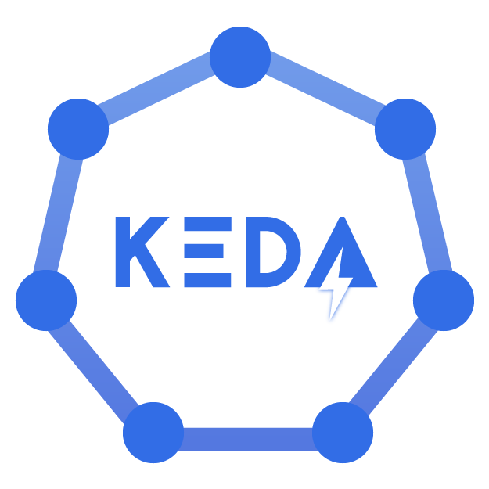
Custom Metrics AutoScaler
Kubernetes Event-Driven Autoscaling ( KEDA )

Slide 2
AutoScaling - Introduction
Workloads deployed on OpenShift/k8s cluster should be able to flexibly react to increased/decreased load
To prevent any outages, Latency issues, and avoid resource wastage.
Can be achieved by
Application AutoScaling
Cluster AutoScaling
Cluster AutoScaling:
The cluster autoscaler watches for pods that can't be scheduled on nodes because of resource constraints.
The cluster then automatically increases the number of nodes and removes the nodes when load is low.
Application AutoScaling
Vertical Pod Autoscaler to scale pods vertically (change the resource allocation for a pod)
Horizontal Pod Autoscaler to scale pods horizontally (change the number of pods)
Scale workloads based on resource utilization metrics, ie. CPU and memory usage
scaling based only on CPU and Memory consumption might not always be the best fit.
Modern applications workloads leverages Event Driven Architecture and traditional VPA/HPA may not work.
Wanted to scale applications based on events/metrics from external systems other than CPU and MEMORY.
Notes:
The cluster autoscaler watches for pods that can't be scheduled on nodes because of resource constraints. The cluster then automatically increases the number of nodes;
The Horizontal Pod Autoscaler (HPA) uses the Metrics Server in a Kubernetes cluster to monitor the resource demand of pods. If an application needs more resources, the number of pods is automatically increased to meet the demand.
Both the HPA and cluster autoscaler can also decrease the number of pods and nodes as needed. The cluster autoscaler decreases the number of nodes when there has been unused capacity for a period of time, whereas HPA do it when resource consumption lowers.
HPA is great, but it does have limitations:
It only scales according to the pods resources. If you wants to use other metrics, you'll have to use an Adapter;
Only one Adapter can be used at a time. If you want to use several external resources, then you'll have to merge the metrics into one source beforehand.

Slide 3
Custom Metrics AutoScaler ( CMA )
The Custom Metrics AutoScaler ( CMA ) automatically increase or decrease the number of pods for a deployment, statefulset, custom resource, or job based on custom metrics that are not based only on CPU or memory.
The Custom Metrics Autoscaler operator is based on the upstream project KEDA .
KEDA is a Kubernetes-based Event Driven Autoscaling component. It provides event driven scale for any container running in Kubernetes
KEDA is CNCF Graducated project.
RedHat is one of the Co-Founder of KEDA along with MicroSoft.
The main goal of CMA/KEDA is to enable autoscaling based on events and custom metrics other than pod metrics.
Acts as a thin layer on top of the existing Horizontal Pod AutoScaler, it provides it with external metrics and also manages scaling down to zero
CMA currently supports only the Prometheus, CPU, memory, and Apache Kafka metrics.
The CMA uses a metrics API to convert the external metrics to a form that OpenShift Container Platform can use. The custom metrics autoscaler creates a horizontal pod autoscaler (HPA) that performs the actual scaling.
Notes:
The main goal of CMA/KEDA is to enable autoscaling based on events and custom metrics . It acts as a thin layer on top of the existing Horizontal Pod Autoscaler, it provides it with external metrics and also manages scaling down to zero

Slide 4
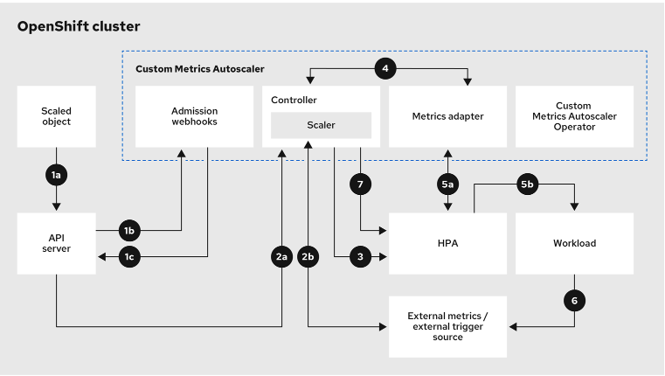
Custom Metrics AutoScaler
Pre-requisites:
Enable monitoring for user-defined projects
Expose metrics from the application at /metrics endpoint ( using ServiceMonitor resource )
Components of CMA
Triggers/Scalers: source of events and metrics that the custom metrics autoscaler uses to determine how to scale.
ScaledObject: custom resource (CR) that define autoscaling of Deployments, StatefulSets or any Custom Resources that are scalable.
ScaledJob: custom resource (CR) to process long running tasks which the autoscaler uses to create Kubernetes Jobs based on the custom metrics.
Only one scaled object or scaled job is allowed for each workload that we want to scale
We cannot use a scaled object or scaled job and the horizontal pod autoscaler (HPA) on the same workload

